Slide 1




Protecting Forests and Infrastructure from Fire with Drones
Presented by: Tracey Begaye
Mentor: Pete Fule, Regent's Professor, School of Forestry, NAU
NASA Space Grant Statewide Symposium
Saturday, April 22, 2023

Slide 2
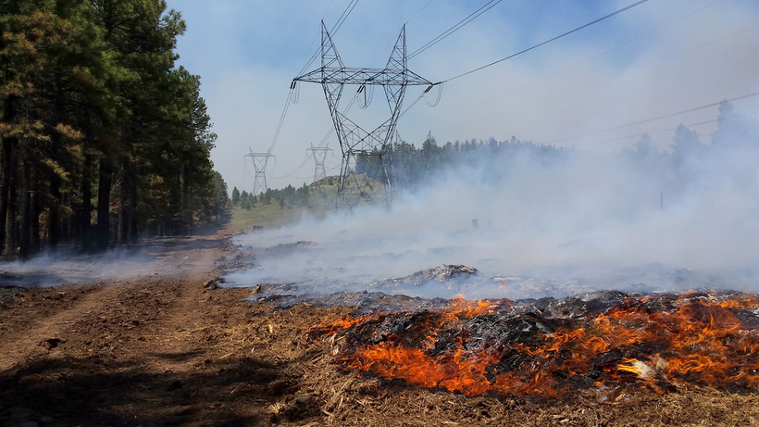
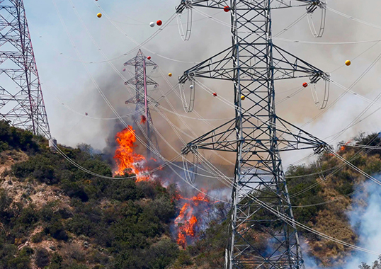

Statement of the Problem
  Utility line corridors affected by forest fire
    Towers serve the Phoenix area
  Research forest fuel using tree metrics
Figure 1: Northern Arizona Forest Fire
Source: Coconino National Forest Photography
Figure 2: Uility Fire
Source: Enriching Technical Knowledge of T&D Professionals

Slide 3
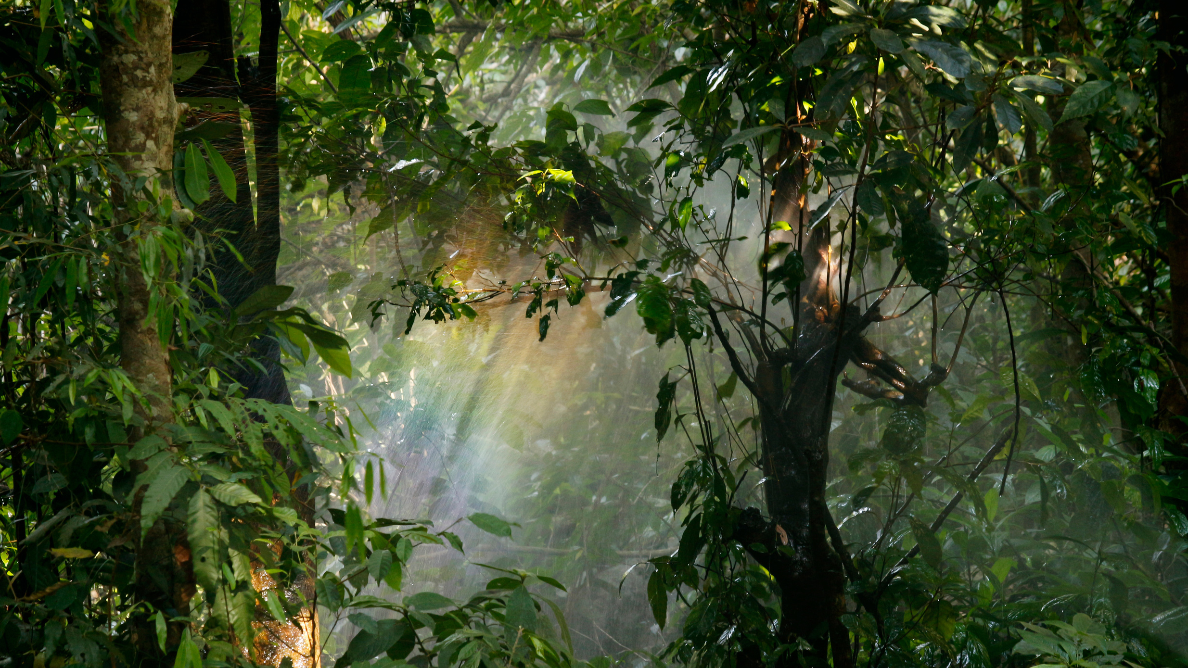
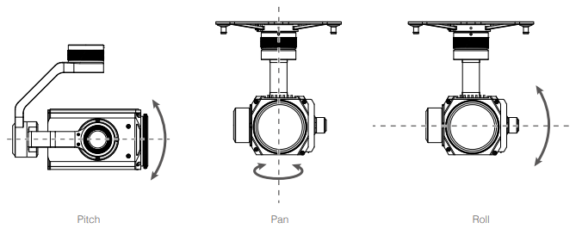
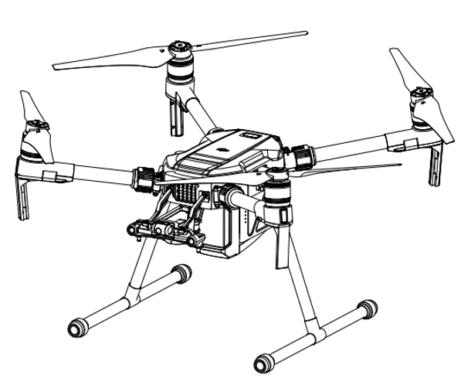
Methods
  Fly drones at different heights over utility line corridors to collect data
    Measure fuel hazards
  Structure from Motion (SfM)
    Technique for three-dimensional visualization using images taken from different locations
  Computer software (Metashape)
    Stitch the photos into a 3-D scene, called a point cloud
Figure 3: Camera Gimbal
Figure 4: DJI Matrice 200

Slide 4
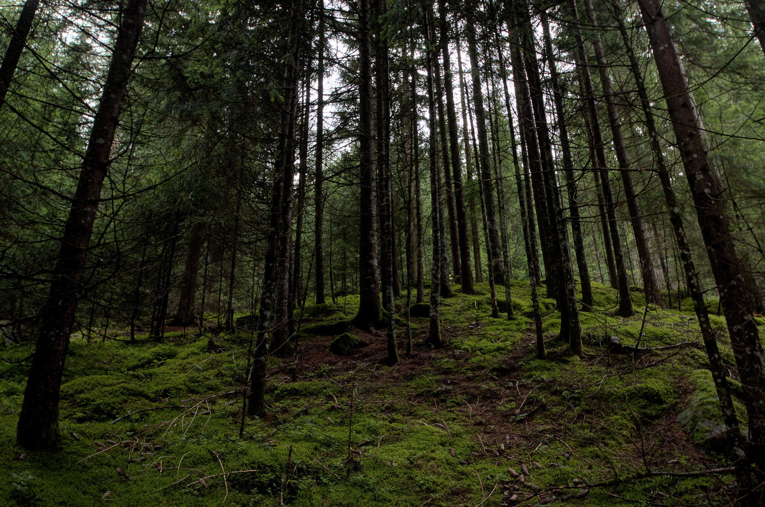
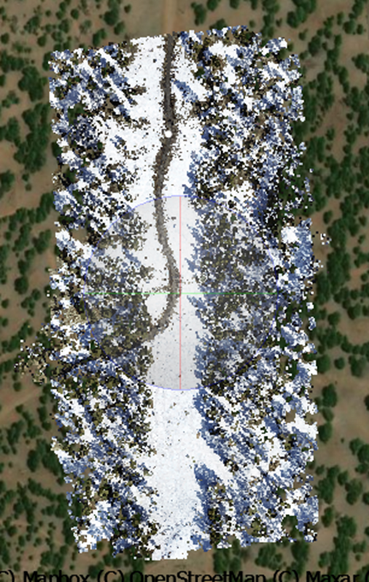
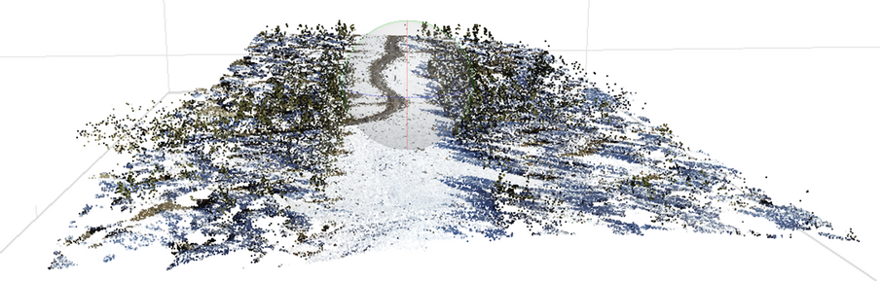
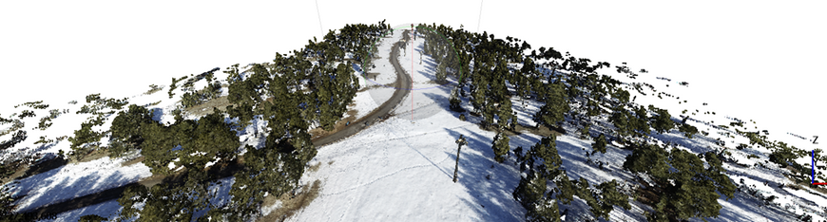
Results
  Use point cloud data to compute forest fuel metrics
    Canopy base height, canopy cover, tree segmentation, individual tree location, & tree height
  These parameters help forecast the behavior of forest fires
Figure 6: Point Cloud
Figure 5: Plot with GPS
Figure 7: Dense Cloud

Slide 5

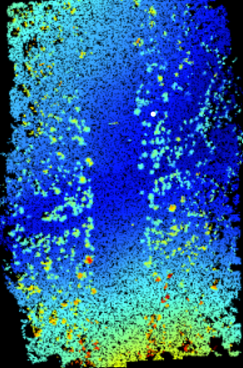
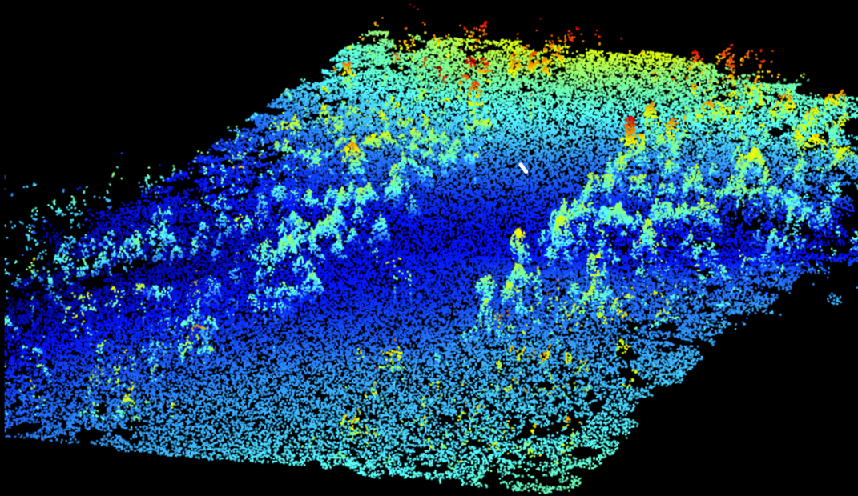
Results -
Continued
  Digital terrain model
    Classification of ground points & elevation
  Accuracy of these models = better tree height estimation
Figure 8: Nadir View
Figure 9: Oblique View

Slide 6
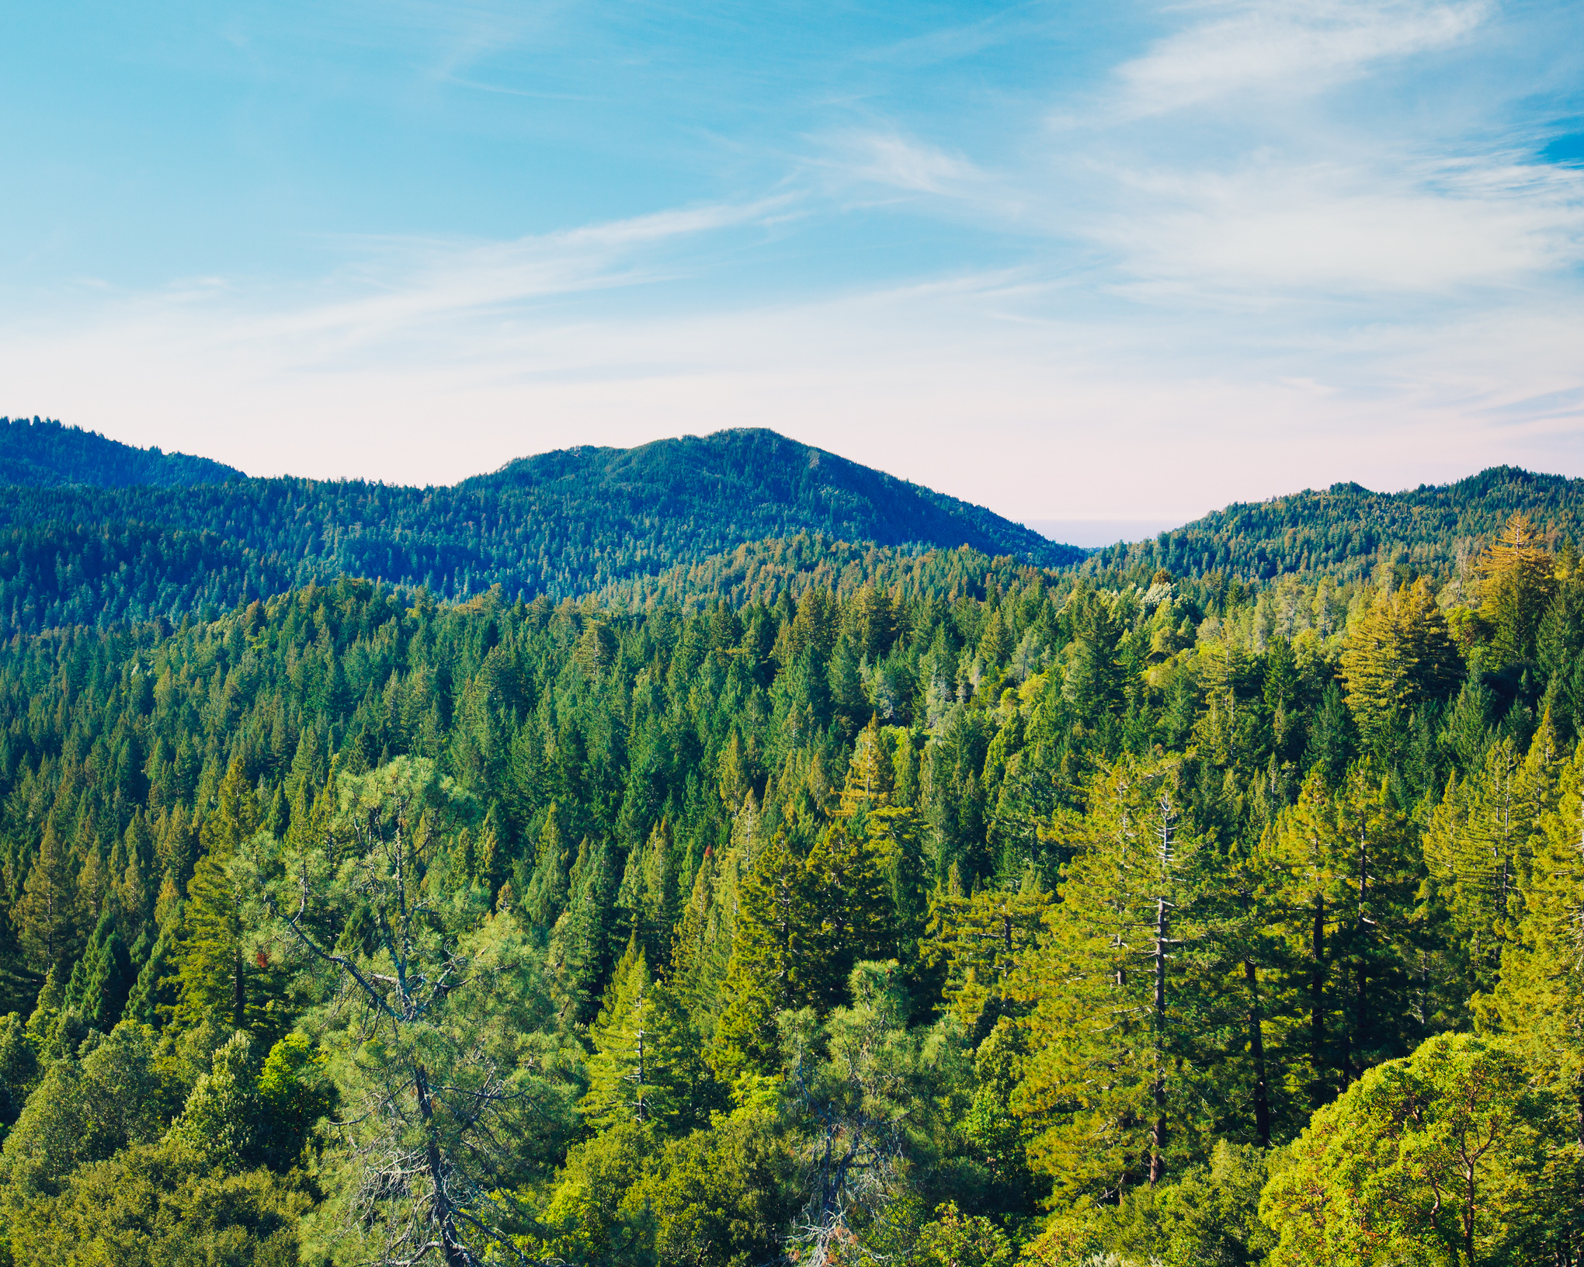
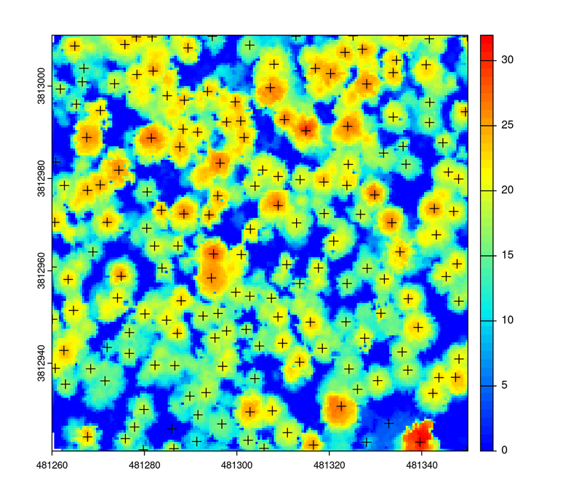
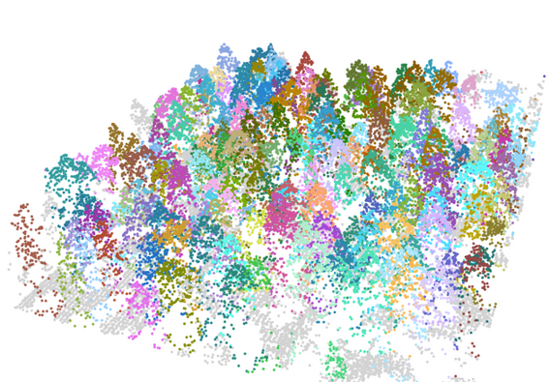
Results - Continued
Coordinates
  Canopy data
    Create a model & it can predict how long/big the fire will be
      Inputs are crucial
    Individual tree location provides tree density & size
  Thinning forests
Tree Height (m)
Figure 10: Tree Segmentation
Coordinates
Figure 11: Individual tree location using canopy height model

Slide 7
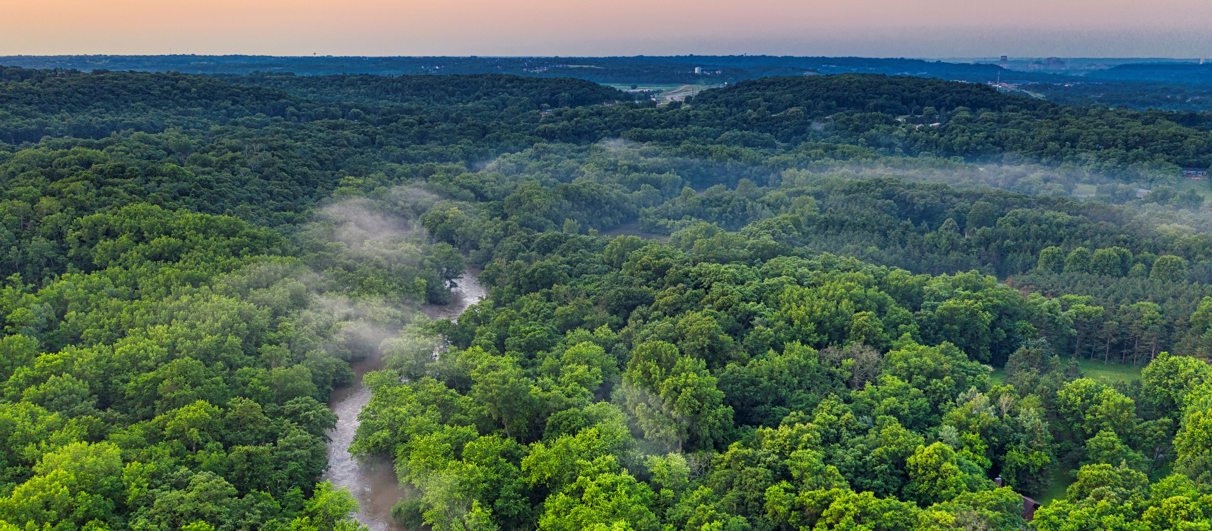



Impact
Meaningful collaborations on Navajo Nation with Diné College & Salt River Project
Foresters, utility providers, & fire managers will all receive access to our research
Maintain & conserve the ecology of Northern
Arizona

Slide 8
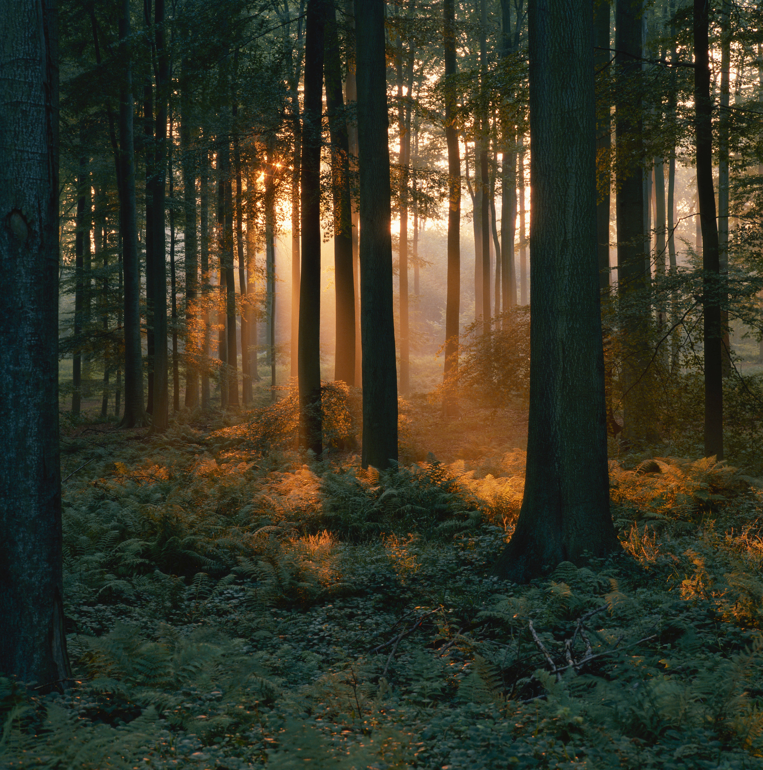
Acknowledgements
  Pete Fule - Mentor, Regent's Professor
  Leo O'Neill - Lab/Group Partner
  NAU/NASA Space Grant Program
    Paloma Rose Davidson (Senior Academic Program Coordinator)
  School of Forestry

Slide 9

Ahéhee'
Thank You!

